Slide 1
LUNG AND COLON CANCERS DETECTION
1

Slide 2

PROJECT VIVA-VOCE PRESENTATION ON
LUNG AND COLON CANCERS DETECTION
By
KOLIPAKA HEMA SUNDAR
Reg. No. 322203320030
IV Semester. M.C.A
Under the Guidance of
Mr. B. BALA KRISHNA
Assistant Professor
DEPARTMENT OF COMPUTER APPLICATIONS
GAYATRI VIDYA PARISHAD COLLEGE OF ENGINEERING (AUTONOMOUS)
VISAKHAPATNAM – 530 048
2022-2024
2

Slide 3
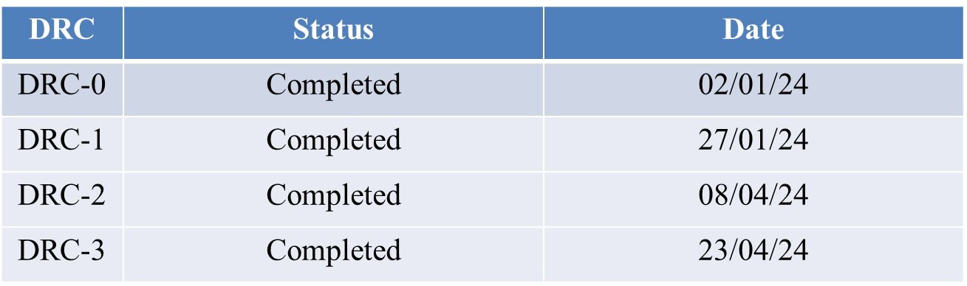
DRC STATUS
3
3

Slide 4
ABSTRACT
Lung and colon cancers are among the most common types of cancer worldwide, and accurate detection and classification of these cancers is crucial for effective treatment and it improves patient outcomes. In this project Median Filtering for Preprocessing and Convolutional Neural Network models like Sequential model , which achieved 98% accuracy and ResNet model , which achieved 97% accuracy for the detection of cancer through histopathological images. Moreover, there are machine learning models like SVM, Decision tree which can classify the cancers, but those are not much accurate. The proposed algorithm has the potential to significantly enhance the efficiency and accuracy of cancer detection and reduces the diagnosing time, ultimately contributing to improved treatment quality and patient outcomes.
4

Slide 5
PROBLEM STATEMENT
Lung and colon cancers are among the most common types of cancer worldwide, and early detection is crucial for effective treatment and improved patient outcomes. However, the manual grading of histopathological images (HI) is time-consuming and subject to error, and non-invasive techniques may not accurately identify sub-categories of these cancers. Therefore, there is a need for better image processing approaches that can accurately detect and classify lung and colon cancers using HI. This project aims to develop an improved algorithm using deep learning techniques that can aid in the early detection and classification of these cancers.
5

Slide 6
LITERATURE SURVEY
[1] Sanidhya et al. presented a CNN Pre-Trained Diagnostic Network for diagnosing lung and colon cancer. Their approach uses a shallow CNN architecture trained on histological images, yielding impressive accuracy rates of 96% and 97% for diagnosing colon and lung cancer, respectively. The shallow CNN architecture leverages pre-trained models to improve accuracy in diagnosing these types of cancers.
[2] Vinod et al. designed a method to identify pulmonary nodules using the watershed algorithm and Gabor filter. Features extracted from these methods were then categorized using SVM. This approach underscores the potential of combining traditional image processing techniques with machine learning for accurate diagnosis.
[3] Mesut et al. developed the DarkNet-19 model for training lung and colon cancer datasets from scratch. They applied the Equilibrium algorithm to select efficient features from the data, which were then classified using Support Vector Machines (SVM). This approach emphasizes the importance of feature selection in achieving better classification results.
6

Slide 7
EXISTING SYSTEM
The existing system likely includes traditional methods of cancer detection, such as manual grading of histopathological images by pathologists, as well as non-invasive techniques like computed tomography (CT) and radiography for lung cancer, and CT colonoscopy for colon cancer. However, the limitations of these existing approaches, including the time-consuming nature of manual grading, the potential for error, and the inability of non-invasive techniques to accurately identify sub-categories of these cancers. Moreover, there are machine learning models which can classify the cancers, but those are not much accurate. So, there is a need for enhanced algorithms and techniques to address the challenges associated with the existing system, particularly in the context of accurately detecting and classifying lung and colon cancers using of complex histopathological images.
7

Slide 8
PROPOSED SYSTEM
In the proposed system, the Convolutional Neural Network for Lung and Colon Cancer Detection method, aims to enhance the accuracy and efficiency of cancer detection and classification in histopathological images. This new approach incorporates advanced components such as the median filtering (MF) approach for noise removal. By leveraging the models like convolutional Neural Network (CNN) Sequential model and ResNet model for cancer detection, the proposed system seeks the grading of histopathological images and accurately identify sub-categories of lung and colon cancers. This system represents a significant advancement in the field of medical imaging and demonstrates superior performance compared to existing approaches.
8

Slide 9
SYSTEM REQUIREMENTS
SOFTWARE REQUIREMENTS
Programming Language : Python ( 3.11 or above)
IDE : VS Code , Google Colab
Front-End : HTML , CSS , JAVASCRIPT
Framework: Flask
9

Slide 10
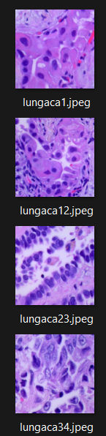
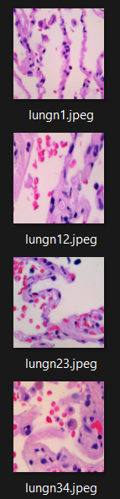
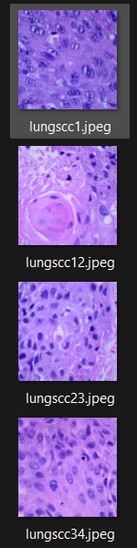
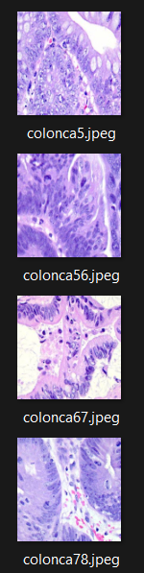
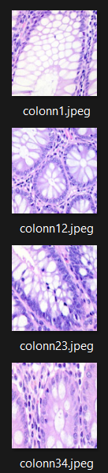
DATASET
LC25000
Lung Images set
Colon Images set
Lun-Ad Lun-Be Lung-Sc
Col-Ad Col-Be
10

Slide 11
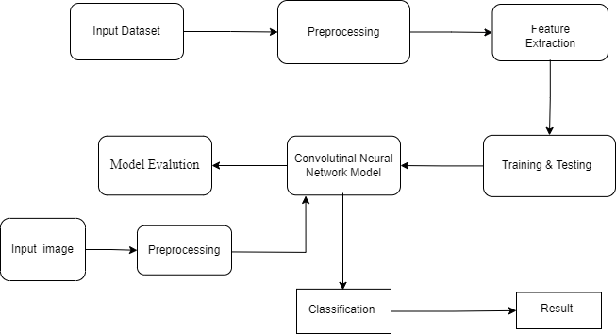
SYSTEM ARCHITECTURE
11

Slide 12
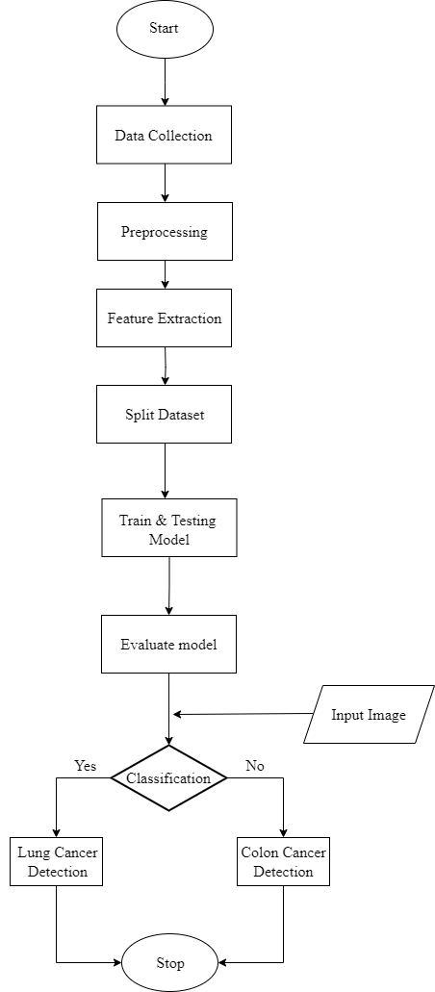
FLOW CHART
12

Slide 13
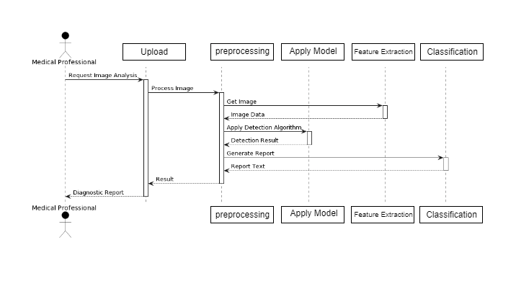
UML SEQUENCIAL DIAGRAM
13

Slide 14
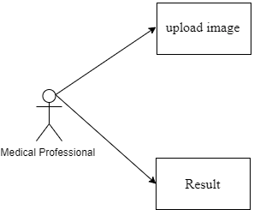
USECASE DIAGRAM
14

Slide 15
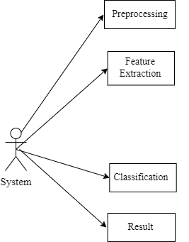
USECASE DIAGRAM
15

Slide 16
CNN Algorithm :- Sequential model
Input:
Batch of images from the Dataset.
Output:
Predicted probabilities of each class.
Steps:
1. Define the input layer:
- Create an input layer with the specified image shape.
- Add layers sequentially:
- Add a Dense layer with 512 units and ReLU activation.
- Add a Dropout layer with a dropout rate of 0.5 to prevent overfitting.
- Add a Dense layer with the number of output classes and softmax activation for classification.
2. Train the model:
- Train the model using the extracted features as input and labels as output.
- Specify the number of epochs and batch size for training.
3. Evaluate the model:
- Evaluate the trained model on the test dataset to assess its performance.
- Obtain metrics such as accuracy to measure the model's effectiveness.
4. Use the model for inference:
- Once trained and evaluated, deploy the model for making predictions on new unseen data.
- Provide input features to the model and obtain predicted probabilities for each class.
16

Slide 17
CNN Algorithm :- ResNet50 model
Input:
Batch of images from the Dataset.
Output:
Predicted probabilities of each class.
Steps:
1. Define the input layer:
- Create an input layer with the specified image shape.
2. Define convolutional and pooling layers:
- Add Conv2D layers with varying numbers of filters, kernel sizes, and ReLU activation functions.
- Add MaxPooling2D layers for down-sampling after each set of Conv2D layers.
3. Define fully connected layers:
- Flatten the output from the last pooling layer.
- Add Dense layers with ReLU activation functions.
- Make Dropout layers between Dense layers to prevent overfitting.
4. Define the output layer:
- Add a Dense output layer with softmax activation for multi-class classification.
17

Slide 18
5. Create the model:
- Combine the defined layers to create the custom CNN model.
6. Compile the model:
- Use an optimizer such as Adamax with a specified learning rate.
- Specify the loss function as categorical cross-entropy.
- Specify metrics such as accuracy for evaluation.
7. Train the model:
- Train the model using the training data, specifying the number of epochs and batch size.
- Validate the model using validation data.
8. Evaluate the model:
- Monitor the training and validation performance metrics, such as accuracy, over the epochs.
18

Slide 19
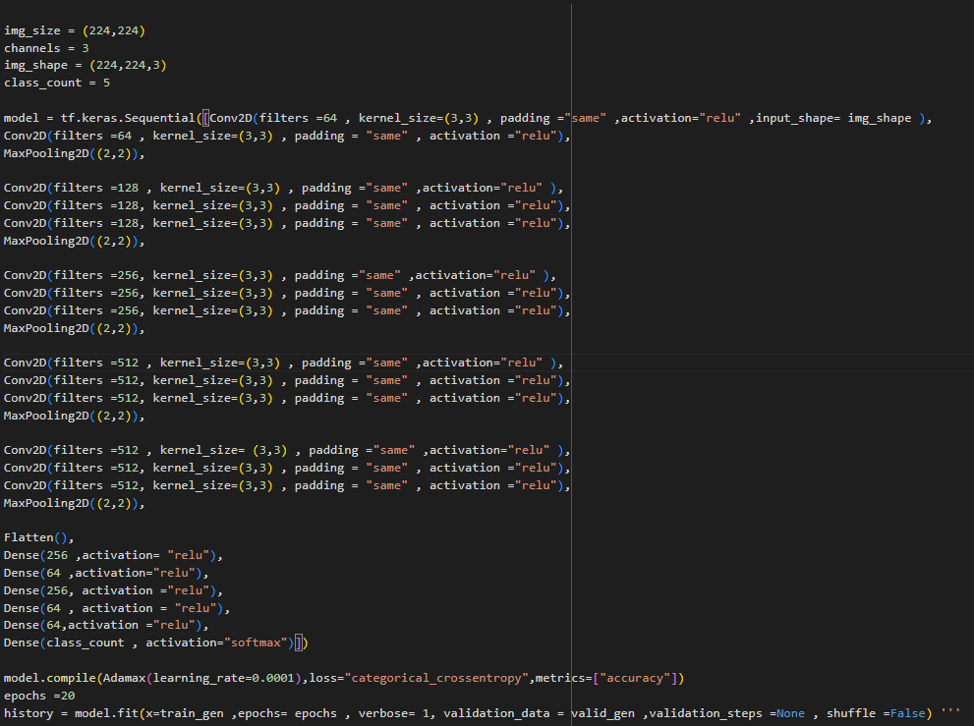
SAMPLE CODE
19

Slide 20
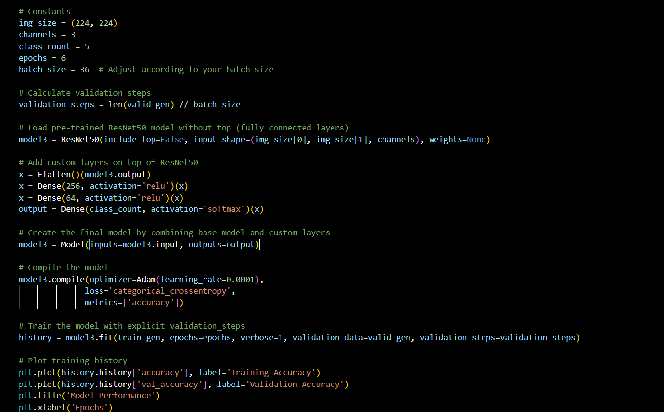
SAMPLE CODE
20

Slide 21
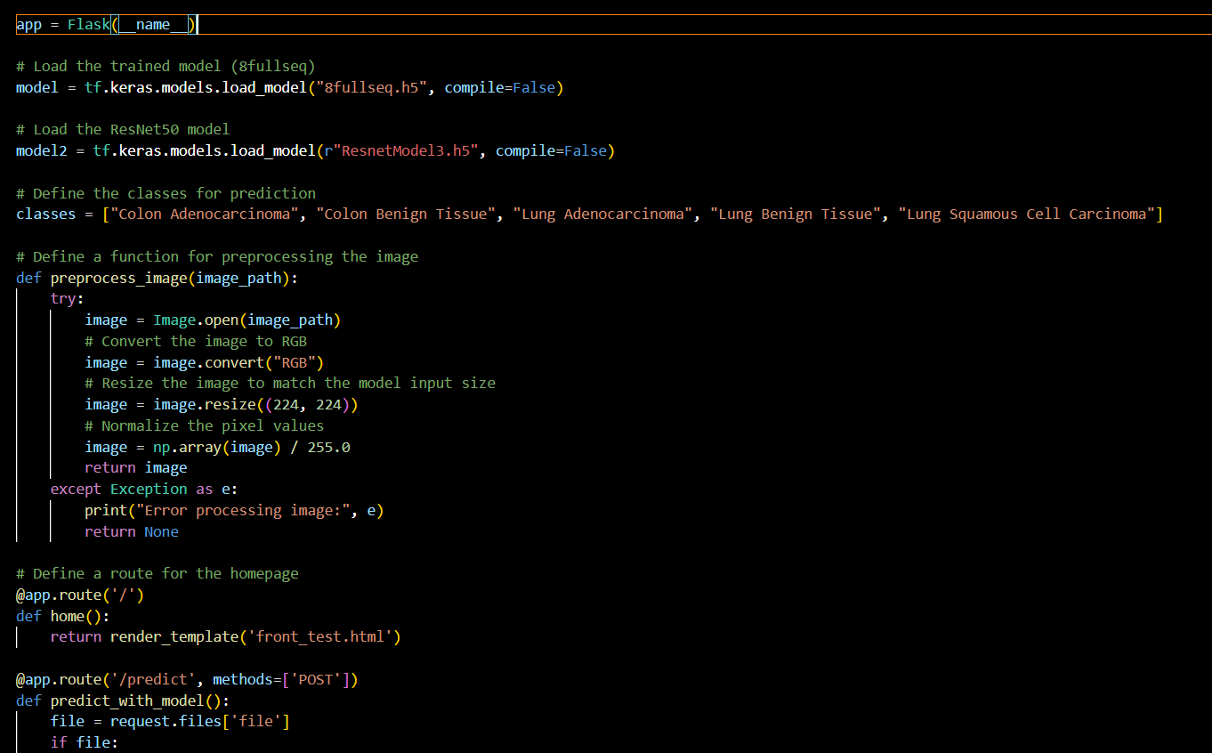
FLASK CODE: -
21

Slide 22
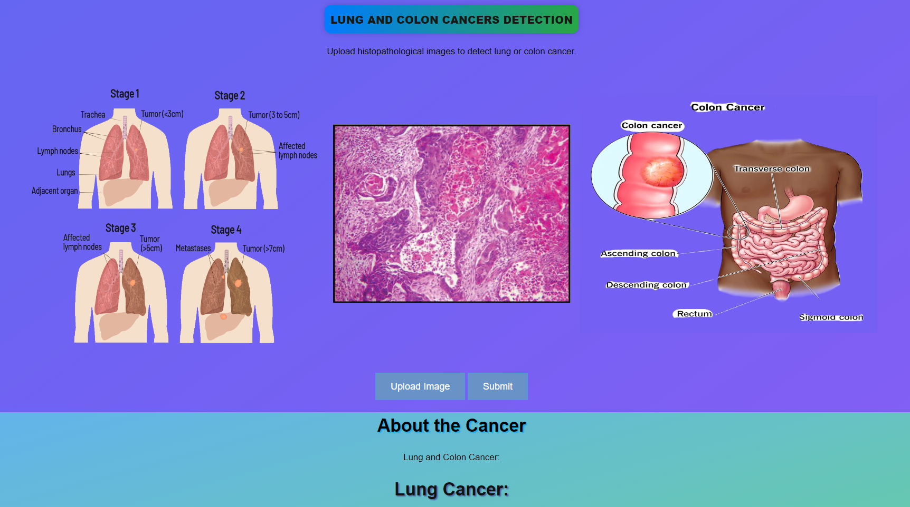
OUTPUT SCREENS
22

Slide 23
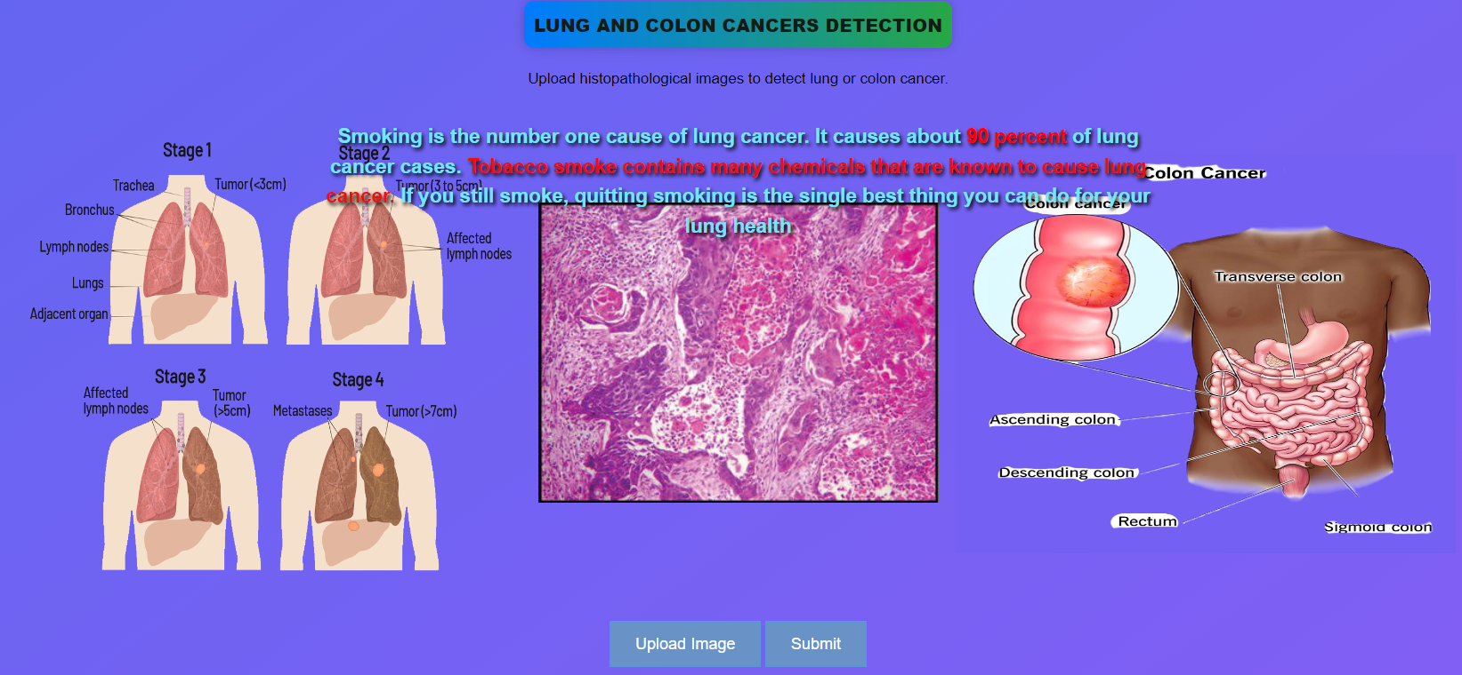
OUTPUT SCREENS
Fig:- Curser at the left image
23

Slide 24
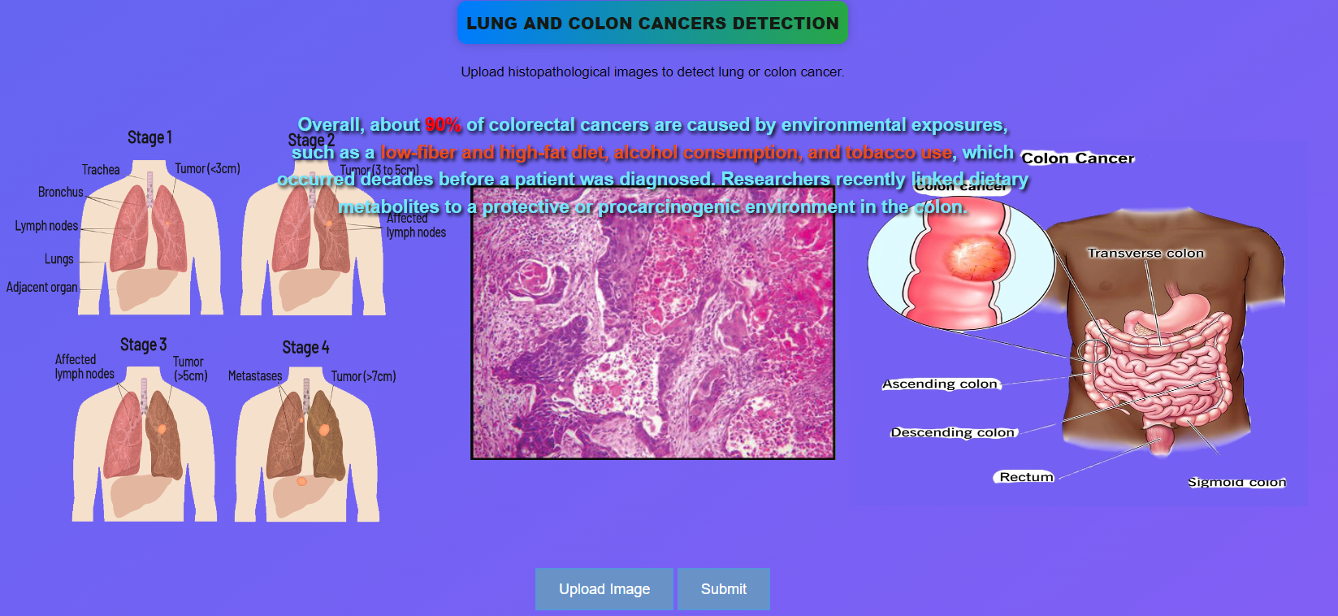
OUTPUT SCREENS
Fig:- Curser at the right Image

Slide 25
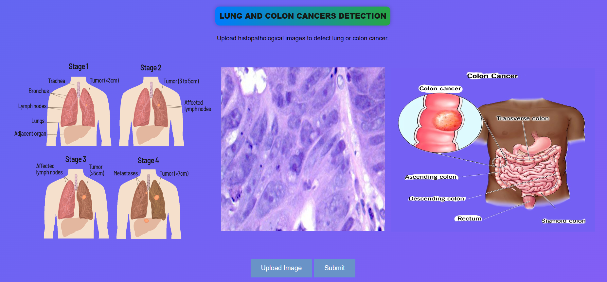
OUTPUT SCREENS
Fig:- Uploaded Image
25

Slide 26
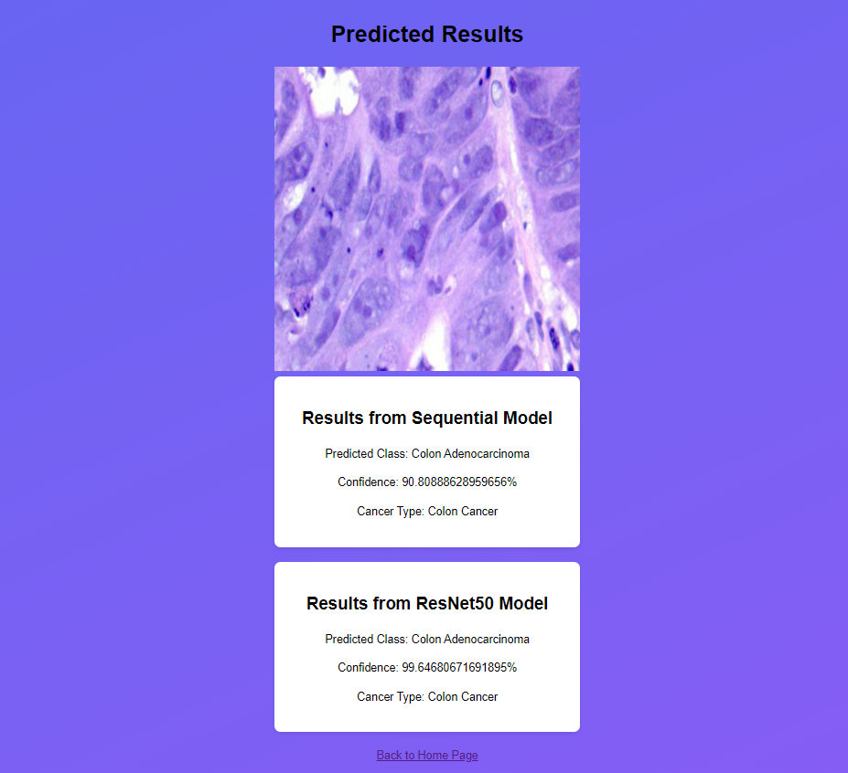
OUTPUT SCREENS
26

Slide 27
CONCLUSION
In conclusion, Convolutional Neural Networks (CNNs) for Lung and Colon Cancer Detection gives better results in diagnosing cancer. By using deep CNN models like the Sequential model, which achieved 98% accuracy , and the ResNet50 model, which achieved 97% accuracy, the system enhances its accuracy in classifying histopathological images compared to traditional machine learning models. This advancement in medical imaging reduces the time needed for diagnosing cancer and performs better than existing approaches, which helps doctors to treat patients more effectively.
27

Slide 28
REFERENCE
[1] Nishio M., Nishio M., Jimbo N., Nakane K. Homology-Based Image Processing for Automatic Classification of Histopathological Images of Lung Tissue. Cancers. 2021;13:1192. Doi: 10.3390/cancers13061192
[2] Mangal S., Chaurasia A., Khajanchi A. Convolution neural networks for diagnosing colon and lung cancer histopathological images. arXiv. 20202009.03878
[3] Mehmood S., Ghazal T.M., Khan M.A., Zubair M., Naseem M.T., Faiz T., Ahmad M. Malignancy detection in lung and colon histopathology images using transfer learning with class selective image processing.
[3] Tharsanee, R.M., Soundariya, R.s., Kumar, A.S., Karthiga, M., & Sountharrajan, S. (2021). Deep Convolutional neural network-based image classification for COVID-19 diagnosis. In Data Science for COVID-19 (pp. 117-145). Academic Press.
[4] Sarwinda D., Paradisa R.H., Bustamam A., Anggia P. Deep learning in image classification using residual network (ResNet) variants for detection of colorectal cancer. Procedia Comput. Sci. 2021;179:423–431.
[5] Shim W.S., Yim K., Kim T.-J., Sung Y.E., Lee G., Hong J.H., Chun S.H., Kim S., An H.J., Na S.J., et al. DeepRePath: Identifying the Prognostic Features of Early-Stage Lung Adenocarcinoma Using Multi-Scale Pathology Images and Deep Convolutional Neural Network.
28

Slide 29
THANK YOU
29

